Slide 1
EC7011 -INTRODUCTION TO WEB TECHNOLOGY
B.Vijayalakshmi
Computer Centre
MIT Campus
Anna University

Slide 2
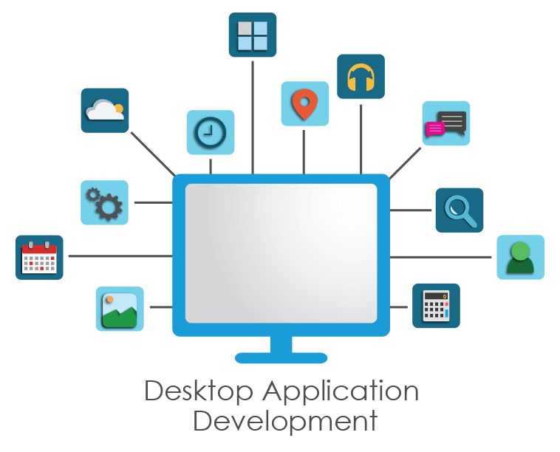
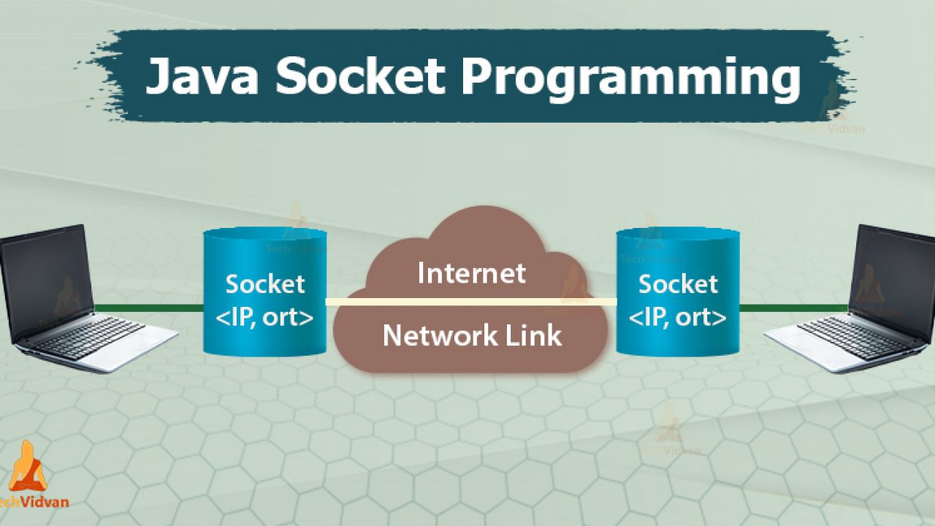
OVERVIEW
Provides an introduction to Java and basic Web concepts
UNIT I - JAVA FUNDAMENTALS
Features of object oriented programming languages using Java
To design and create user interfaces using Java frames and applets
Desktop Applications
UNIT II - JAVA NETWORKING FUNDAMENTALS
To have a basic idea about network programming using Java
Networking is a concept of connecting two or more computing devices together so that we can share resources.
Java socket programming provides facility to share data between different computing devices.

Slide 3
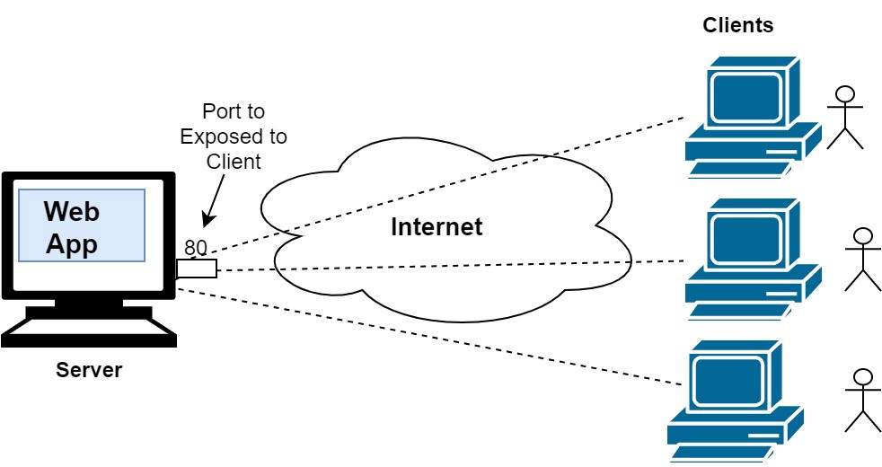
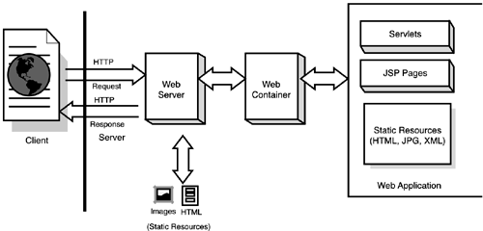
OVERVIEW
Web Application
A Web application (Web app) is an application program that is stored on a remote server and delivered over the Internet through a browser interface.

Slide 4
OVERVIEW
UNIT III - CLIENT SIDE TECHNOLOGIES
To create simple Web pages and provide client side validation
UNIT IV - SERVER SIDE TECHNOLOGIES
To create dynamic web pages using server side scripting
UNIT V - APPLICATION DEVELOPMENT ENVIRONMENT
To understand the MVC concept using Struts, Hibernate and Spring
Syllabus

